Slide 1
Emmanuel Deletang, Solutions Architect
06 17 94 07 86
Emmanuel.deletang@mongoDB.com
Notes:
Vision, and what we are doing to achieve that
Market trends
Positioning with MarkLogic – what, when and where

Slide 2


Relational
Expressive Query Language
& Secondary Indexes
Strong Consistency
Enterprise Management
& Integrations
Notes:
A lot of people expect us to come in and bash relational database or say we don’t think they’re good. And that’s simply not true.
Relational databases has laid the foundation for what you’d want out of a database, and we absolutely think there are capabilities that remain critical today
Expressive query language & secondary Indexes. Users should be able to access and manipulate their data in sophisticated ways – and you need a query language that let’s you do all that out of the box. Indexes are a critical part of providing efficient access to data. We believe these are table stakes for a database.
Strong consistency. Strong consistency has become second nature for how we think about building applications, and for good reason. The database should always provide access to the most up-to-date copy of the data. Strong consistency is the right way to design a database.
Enterprise Management and Integrations. Finally, databases are just one piece of the puzzle, and they need to fit into the enterprise IT stack. Organizations need a database that can be secured, monitored, automated, and integrated with their existing IT infrastructure and staff, such as operations teams, DBAs, and data analysts.

Slide 3
The World Has Changed
Data Risk
Time Cost
facebook
Uber
Air bnb
Notes:
But of course the world has changed a lot since the 1980s when the relational database first came about.
First of all, data and risk are significantly up.
In terms of data
90% data created in last 2 years - think about that for a moment, of all the data ever created, 90% of it was in the last 2 years
80% of enterprise data is unstructured - this is data that doesn’t fit into the neat tables of a relational database
Unstructured data is growing 2X rate of structured data
At the same time, risks of running a database are higher than ever before. You are now faced with:
More users - Apps have shifted from small internal departmental system with thousands of users to large external audiences with millions of users
No downtime - It’s no longer the case that apps only need to be available during standard business hours. They must be up 24/7.
All across the globe - your users are everywhere, and they are always connected
On the other hand, time and costs are way down.
There’s less time to build apps than ever before. You’re being asked to:
Ship apps in a few months not years - Development methods have shifted from a waterfall process to an iterative process that ships new functionality in weeks and in some cases multiple times per day at companies like Facebook and Amazon.
And costs are way down too. Companies want to:
Pay for value over time - Companies have shifted to open-source business and SaaS models that allow them to pay for value over time
Use cloud and commodity resources - to reduce the time to provision their infrastructure, and to lower their total cost of ownership

Slide 4


NoSQL
Expressive Query Language
& Secondary Indexes
Flexibility
Strong Consistency
Scalability
& Performance
Enterprise Management
& Integrations
Always On,
Global Deployments
Notes:
Because the relational database was not designed for modern applications, starting about 10 years ago a number of companies began to build their own databases that are fundamentally different. The market calls these NoSQL.
NoSQL databases were designed for this new world…
Flexibility. All of them have some kind of flexible data model to allow for faster iteration and to accommodate the data we see dominating modern applications. While they all have different approaches, what they have in common is they want to be more flexible.
Scalability + Performance. Similarly, they were all built with a focus on scalability, so they all include some form of sharding or partitioning. And they're all designed to deliver great performance. Some are better at reads, some are better at writes, but more or less they all strive to have better performance than a relational database.
Always-On Global Deployments. Lastly, NoSQL databases are designed for highly available systems that provide a consistent, high quality experience for users all over the world. They are designed to run on many computers, and they include replication to automatically synchronize the data across servers, racks, and data centers.
However, when you take a closer look at these NoSQL systems, it turns out they have thrown out the baby with the bathwater. They have sacrificed the core database capabilities you’ve come to expect and rely on in order to build fully functional apps, like rich querying and secondary indexes, strong consistency, and enterprise management.

Slide 5

Nexus Architecture
Expressive Query Language
& Secondary Indexes
Flexibility
Strong Consistency
Scalability
& Performance
Enterprise Management
& Integrations
Always On,
Global Deployments
Notes:
MongoDB was built to address the way the world has changed while preserving the core database capabilities required to build modern applications.
Our vision is to leverage the work that Oracle and others have done over the last 40 years to make relational databases what they are today, and to take the reins from here. We pick up where they left off, incorporating the work that internet pioneers like Google and Amazon did to address the requirements of modern applications.
MongoDB is the only database that harnesses the innovations of NoSQL and maintains the foundation of relational databases – and we call this our Nexus Architecture.

Slide 6
MongoDB Technical Capabilities
Application
Dynamic Document Schema
2. Native language drivers
db.customer.insert({…})
db.customer.find({
name: ”John Smith”})
{ name: “John Smith”,
date: “2013-08-01”),
address: “10 3rd St.”,
phone: [
{ home: 1234567890},
{ mobile: 1234568138} ]
}
Driver
Query Router
3. High availability
Replica sets
Shard 1
Shard 2
Shard N
4. High performance
Data locality
Rich Indexes
RAM
Primary
Primary
Primary
…
Secondary
Secondary
Secondary
Secondary
Secondary
Secondary
5. Horizontal scalability
Sharding

Slide 7






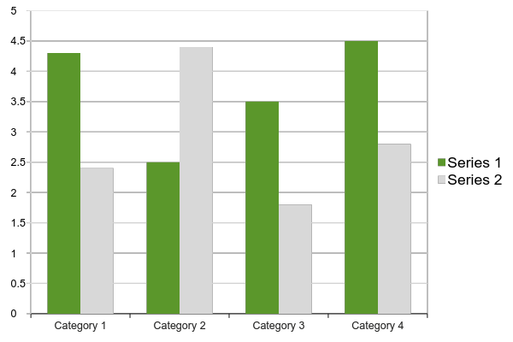

Context – Business Intelligence (BI)
Business intelligence (BI) is a technology-driven process for analyzing data and presenting actionable information to help corporate executives, business managers and other end users make more informed business decisions.
BI encompasses a variety of tools, applications and methodologies that enable organizations to collect data from internal systems and external sources, prepare it for analysis, develop and run queries against the data, and create reports, dashboards and data visualizations to make the analytical results available to corporate decision makers as well as operational workers.
Porta Ultricies
Commodo Porta
Notes:
Set the context for the discussion – define what is in scope and what is not For the purpose of this webinar, Analytics = BI (advanced algorithms and data manipulation, e.g. machine learning, is out of scope)

Slide 8
Technical Deep Dive

Slide 9
Documents are Rich Data Structures
{
first_name: ‘Paul’,
surname: ‘Miller’,
cell: 447557505611,
city: ‘London’,
location: [45.123,47.232],
Profession: [‘banking’, ‘finance’, ‘trader’],
cars: [
{ model: ‘Bentley’,
year: 1973,
value: 100000, … },
{ model: ‘Rolls Royce’,
year: 1965,
value: 330000, … }
]
}
String
Number
Typed field values
Geo-Location
Fields can contain arrays
Fields
Fields can contain an array
of sub-documents

Slide 10















Drivers & Frameworks
Java
Ruby
Python
Perl
MEAN Stack
Morphia
Notes:
Support for the most popular languages and frameworks

Slide 11
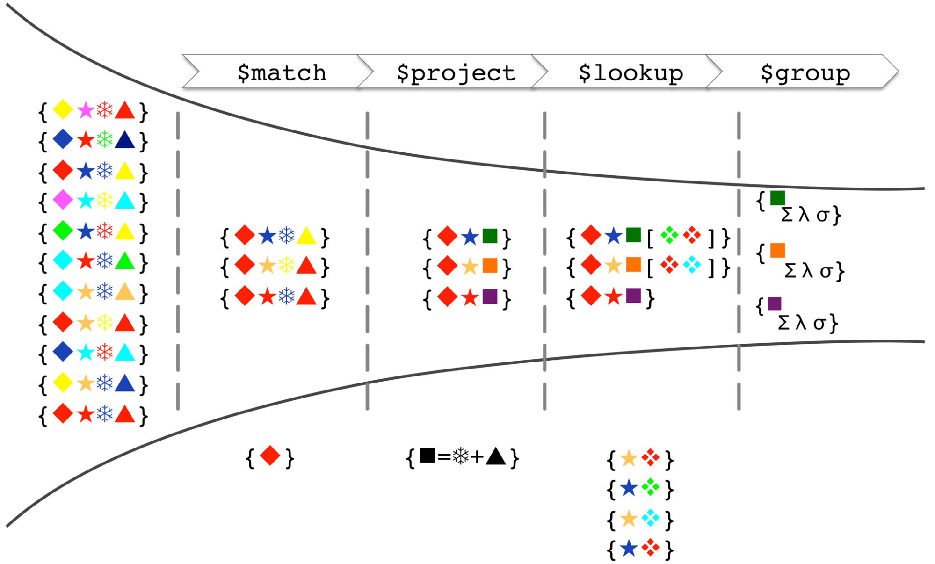
Model of the Aggregation Framework
Notes:
Start with the original collection; each record (document) contains a number of shapes (keys), each with a particular color (value)
$match filters out documents that don’t contain a red diamond
$project adds a new “square” attribute with a value computed from the value (color) of the snowflake and triangle attributes
$lookup performs a left outer join with another collection, with the star being the comparison key
Finally, the $group stage groups the data by the color of the square and produces statistics for each group

Slide 12
BI tools
IBM , power builder
MicroStrategy
Qlik
tableau Software
TIBCO Software
COGNOS
Pentaho ….
They speak only SQL (Structured Query Language) or ODBC , OLEDB ….

Slide 13
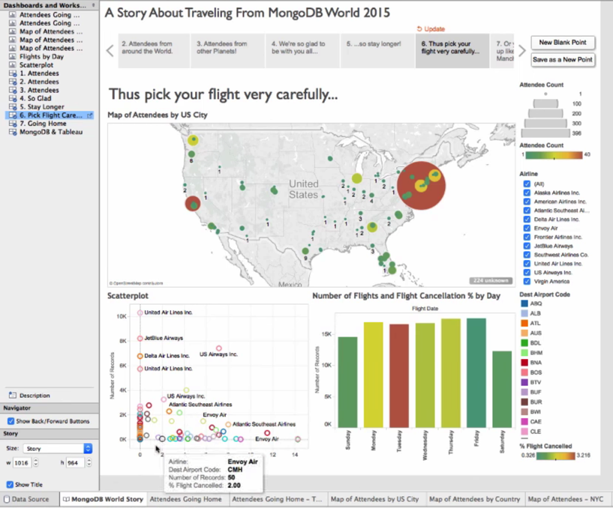
MongoDB Connector for BI
Visualize and explore multi-dimensional documents using SQL-based BI tools. The connector does the following:
Provides the BI tool with the schema of the MongoDB collection to be visualized
Translates SQL statements issued by the BI tool into equivalent MongoDB queries that are sent to MongoDB for processing
Converts the results into the tabular format expected by the BI tool, which can then visualize the data based on user requirements
Notes:
That’s where the BIC comes in!

Slide 14
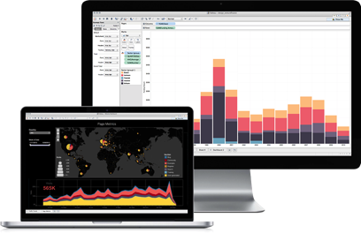

Location & Flow of Data
MongoDB BI Connector
{name: “Andrew”,
address: {street:…}}
Analytics & visualization
Table
Mapping meta-data
Document
Application data
ODBC
MongoDB BI Connector
Analytics & visualization
Application data
Notes:
How it works: 500ft view

Slide 15
Defining Data Mapping
PostgreSQL
MongoDB-specific Foreign Data Wrapper
mongodrdl
mongobischema
DRDL
mongodrdl --host 192.168.1.94 --port 27017 -d myDbName \ -o myDrdlFile.drdl
mongobischema import myCollectionName myDrdlFile.drdl
Notes:
How it works: 100ft view

Slide 16
Tools
mongobiuser
can modify users in the MongoDB Connector for BI.
mongodrdl
generates database schema information for use with the MongoDB Connector for BI.
mongobischema
will load the resulting files into the MongoDB Connector for BI.

Slide 17
Internals
Use mongodrdl to generate a schema based on this collection by running the following command:
mongodrdl -d test -c abc -o schema.drdl
Field Types :
The MongoDB Connector for BI will correctly map fields that always contain the same data type into the relational model.
Schema generation will deal specially with the following cases:
Dates
data_date as the SQL timestamp type.
Timestamps
data_timestamp as a varchar string type.
Geospatial
If a collection contains a geospatial index, the connector will map the indexed field into an array of numeric longitude-latitude coordinates.

Slide 18
Optionally Manually Edit DRDL File
Redact attributes
Use more appropriate types (sampling can get it wrong)
Rename tables
Rename columns
Build new views using MongoDB Aggregation Framework
e.g., $lookup to join 2 tables
table: homesales collection: homeSales pipeline: [] columns: - name: _id mongotype: bson.ObjectId sqlname: _id sqltype: varchar - name: address.county mongotype: string sqlname: address_county sqltype: varchar - name: address.nameOrNumber mongotype: int sqlname: address_nameornumber sqltype: varchar
Notes:
We support flexibility and customization (to a point) in the DRDL

Slide 19
When using ?

Slide 20
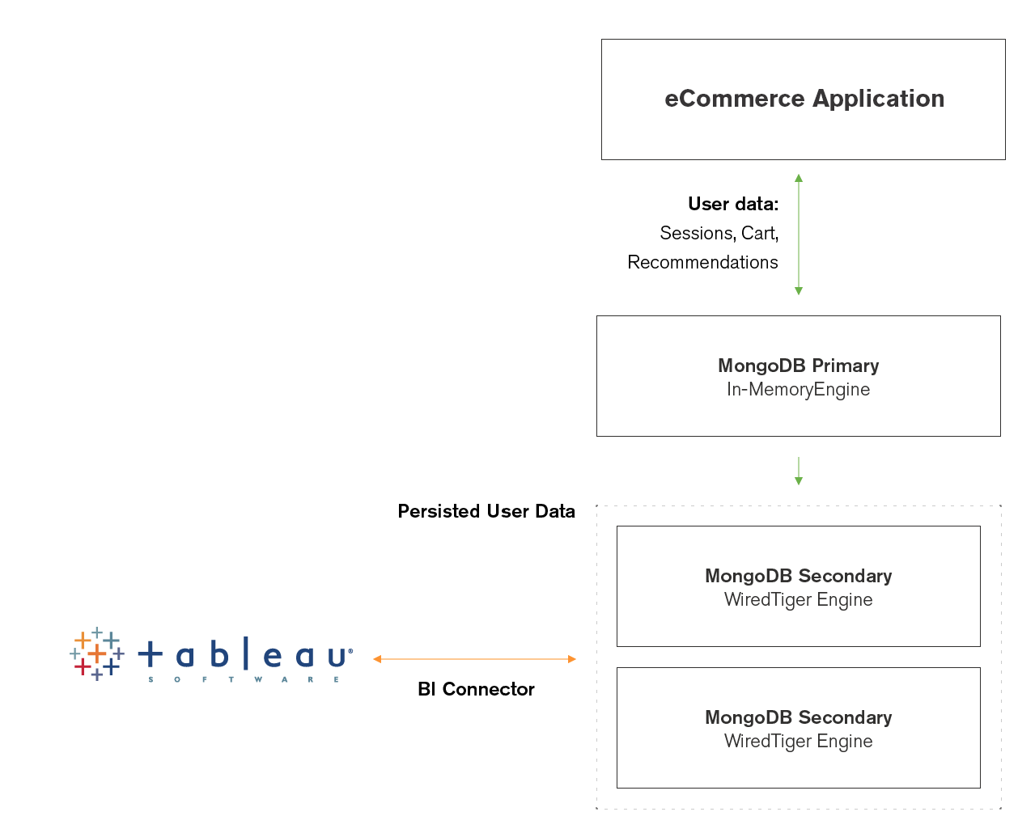


Replica Sets – Workload Isolation
Replica sets enable workload isolation.
Example: Operational workloads on the primary node, analytical workloads on the secondary nodes

Slide 21
Next Steps
Download the MongoDB 3.2 Whitepaper
https://www.mongodb.com/collateral/mongodb-3-2-whats-new
Try the MongoDB Connector for BI
https://www.mongodb.com/lp/download/mongodb-enterprise
Review the docs!
https://docs.mongodb.org/bi-connector/
https://docs.mongodb.org/bi-connector/installation/
https://docs.mongodb.org/bi-connector/schema-configuration/
https://docs.mongodb.org/bi-connector/components/
FAQ
https://docs.mongodb.org/bi-connector/faq/
Notes:
RTFM

Slide 22
BI connector V2
Support of multi os
Collation
LOG support
Decimal support
3.4 support
News drivers mysql odbc drivers will be use

